Slide 1
JavaScript – Advanced Features

Slide 2
Pre-Requisite
Level 100 – 300 session (No kidding here)
Basic knowledge of JavaScript concepts like
Data type
Variable
Loops
Function

Slide 3
Overview
Scope – What is it and how is it different that other programming languages like C, C++, Java or C#

Slide 4
Scope

Slide 5


Myth – JavaScript is an interpreted language
Compiler
Engine
Scope
Responsible for parsing and generating Abstract Syntax Tree (AST), which engine can execute
Responsible for execution of program
A lookup table for variables
Notes:
Program gets compiled right before its execution, the difference can be in nanoseconds!
Engine talks to compiler and scope during execution. Compiler will ask scope to declare variables and hold it. Engine will then talk to scope during execution

Slide 6
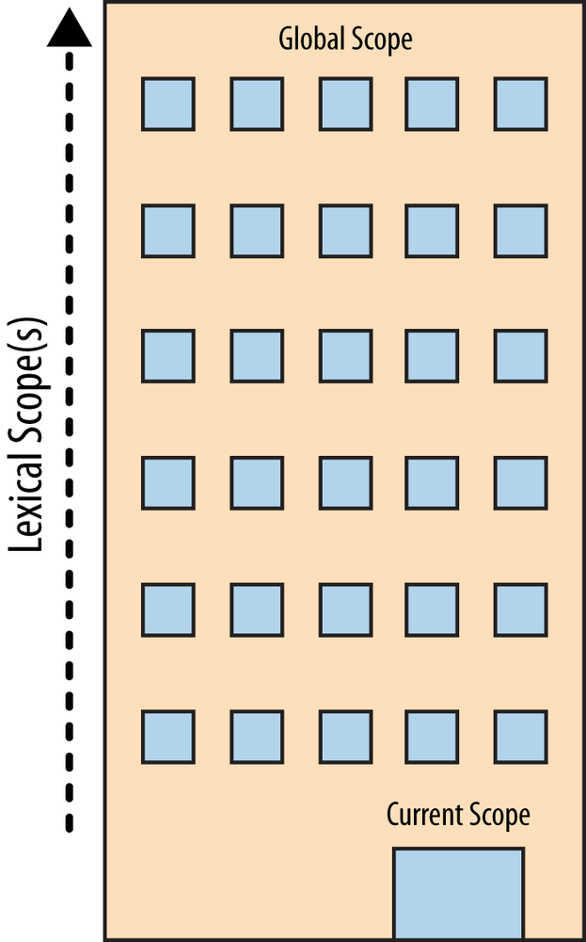
Lexical Scope

Slide 7
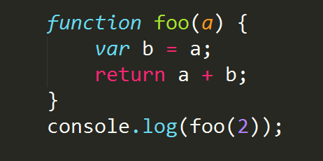
Lexical Scope

Slide 8
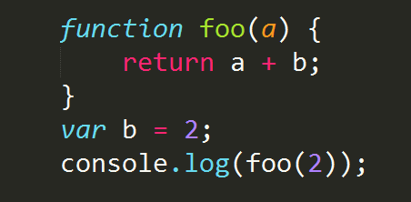
Nested Scope

Slide 9
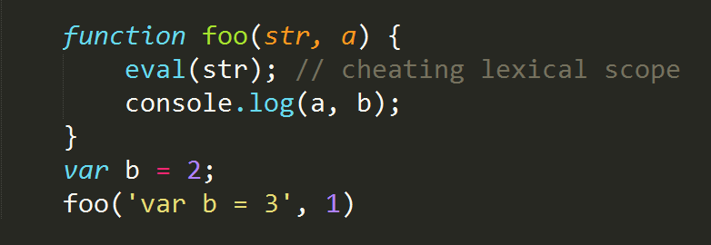
Cheating Lexical Scope

Slide 10
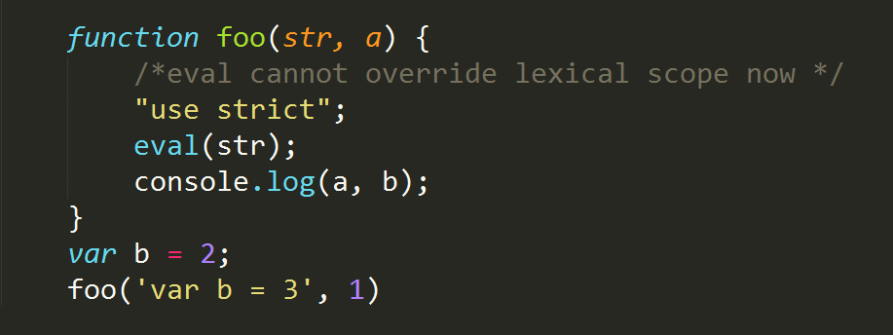
Cheating Lexical Scope

